Slide 1
Maternal Wellness
What should we know about depression and anxiety during the perinatal and postpartum period?

Slide 2
Maternal Wellness
Discussion Questions:
What should we know about Perinatal and Postpartum Depression and Anxiety Disorders?
Presenter:
Motherhood for most women is a phase they most look forward to in their lives.
What does Motherhood really mean? What does it entail? What can it look like?
What is maternal depression and anxiety?
Can this also affect fathers?
How can we support our mothers and fathers?

Slide 3
What is Maternal Depression and Anxiety?
Happy
Sad
Mad
Anxious
Hopeful
Scared
Irritated

Slide 4
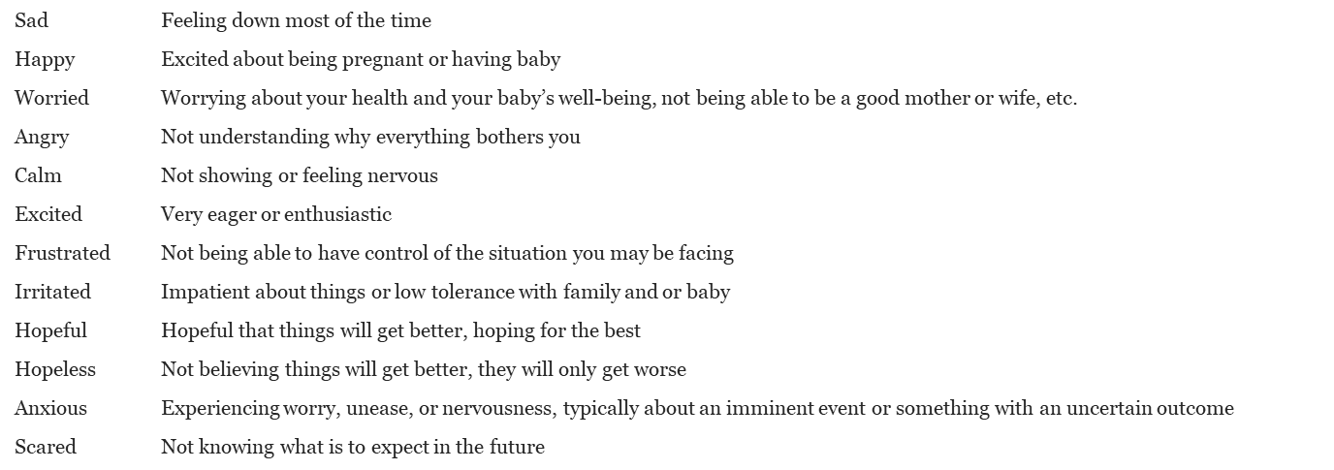
What is Maternal Depression and Anxiety
In order to understand what maternal depression may look like, you have to be able to verbalize your feelings
Discussion Questions:
What words can a person associate with what they are feeling at the moment?
What is maternal depression and anxiety?
Do you think it is common, or does it vary case by case?
Can paternal figures develop depression and anxiety?
Presenter:
It is the number one complication of child birth
It can occur during pregnancy and up to 1-2 years after labor, and/or when mothers stop breastfeeding
It is more common in first pregnancy, but can develop in subsequent pregnancies
Women dealing with grief or divorce, are at higher risk of experiencing maternal depression
Maternal depression and anxiety are common illnesses women may go through during their childbearing period

Slide 5
During Pregnancy

Slide 6
During Pregnancy
Discussion Questions:
Does maternal depression and anxiety have the same symptoms during and after pregnancy?
Can anyone in the audience tell us what maternal depression and anxiety may look like during pregnancy?
Presenter:
Maternal depression and anxiety during pregnancy can manifest the following ways:
Frequent crying or weeping, and not understanding the reasons why
Trouble sleeping
Fatigued or low energy
Changes in appetite, eating too much, or not eating enough. (Keep in mind not to confuse PMAD with an eating disorder)
Loss of enjoyment in once pleasurable activities
Increased anxiety such as worrying extensively about the fetus and/or labor
Short of breath, recurrent thoughts, and panic attacks
Worrying whether or not they will become fit mothers or fathers
Teen Pregnancy:
About one half of adolescent mothers experience depression symptoms in the early postpartum period
Untreated depression can lead to unhealthy behaviors, such as substance misuse, promiscuity, and additional pregnancies
Experience of social isolation, pressure from society, and low self-esteem
Experiencing low maternal/paternal self-efficacy, a belief in one’s ability to adequately parent
Family conflict/multiple families living in the home/parenting styles/stress with parents
History of physical and/or sexual abuse
Interference with transitional phases of growth and development during adolescence
Struggle with balancing their identity while being a parent

Slide 7
Baby Blues

Slide 8
Baby Blues
Discussion Questions:
Can someone tell me what the baby blues are?
Presenter:
Baby Blues are very common and can affect 40% to 80% of women after delivery
The range of hormones can change drastically. Women may be able to notice changes within 48 hours as their hormones begin to shift
Baby blues symptoms should diminish within two weeks
Presenter/Information:
Symptoms can include and described as:
Irritability (impatient, low tolerance for individuals and/or situations)
Anxiety
Frustration
Feeling overwhelmed
Rapid mood changes
Exhaustion (lack of sleep) for days, weeks and could last up to 2 months
Sleep is important during the first six weeks after delivery, resulting in a quicker recovery

Slide 9
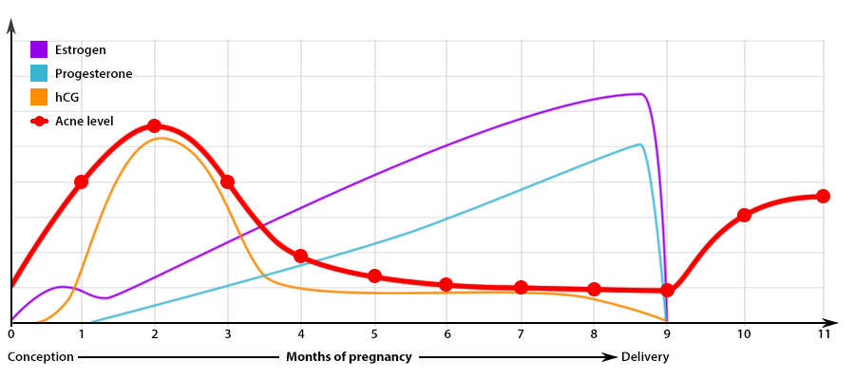
Hormonal Fluctuations
Notes:
HCG: Human chronic gonadotropin

Slide 10
Hormones
Discussion Questions:
Why are hormones important?
Presenter:
As you can see in this chart, the levels of estrogen and progesterone during conception and pregnancy, and after delivery change drastically
When pregnancy occurs, both progesterone and estrogen are produced in the placenta, and their levels continue to elevate throughout the pregnancy
Both hormones help with the expansion of the uterus and help sustain the placenta, and the combination of their high levels suppress further ovulation during pregnancy
Progesterone also encourages the growth of milk-producing glands in the breast during pregnancy
Estrogen smooths muscles to relax the uterus, ligaments, and pelvis to enlarge, accommodate and support pregnancy. It decreases the ability of small muscles to contract, preventing ligaments to stretch as the uterus grows and provides support and thus preventing preterm labor.
Oxytocin allows milk ducts in the breast and later in pregnancy to produce breast milk. It also causes “let-down” of milk during skin-to-skin contact or when baby is ready to feed.
Changes in the Body:
Blood volume increases by one-third to one-half
Swelling in legs and arms can occur, but check if one does have a high blood pressure condition
Women after delivery will try to go back to normal
Estrogen and progesterone will decrease after delivery, but oxytocin goes up and relaxing goes down
Serotonin levels may decrease if hormones are unbalanced
Need to make sure one is drinking fluids to compensate for the fluid the body will flush
After delivery, it is important to sleep at least 5-6 hours a day to be able to function
Ask providers to do a full Thyroid panel to rule out any physical factors contributing to the symptoms

Slide 11
During Postpartum

Slide 12
Discussion questions: What is the postpartum period?
Presenter:
Postpartum period primarily includes the first six weeks after delivery, when varying degrees of changes in body and moods occur.
Motherhood is an exciting time in a woman’s life. However, it is important to assess if one is feeling a wide range of emotions due to Baby Blues, postpartum depression or anxiety.
Maternal depression and anxiety are non-discriminating, and can affect women across all economic, educational, and cultural backgrounds
Presenter:
If a mother has a baby within 12 months, doing a check list of the possible symptoms are important. Symptoms can include:
Feeling overwhelmed: Not being able to handle the role of a mother or father
Intense anxiety: Mind racing constantly, not being able to relax
Frequent crying or weeping : Crying and not being able to control it
Irritability or anger: Lack of tolerance in the present moment
Pervasive sadness: Sad constantly but don’t know why
Fatigue or low energy: Can’t sleep when the baby sleeps
Feelings of worthlessness, hopelessness, or guilt: Feeling baby and family are better off with someone else
Changes in sleeping or eating habits: Having trouble sleeping, tired but not be able to sleep.
Lack of concentration or forgetfulness (fogginess or placenta brain): Can’t concentrate, and can’t remember what you are supposed to do next
Intense worries about the baby: Worried something is wrong or something bad is going to happen to baby
A lack of interest in the new-born, or experiencing bonding attachment cognitive issues
Physical symptoms such as headaches, chest pains, and/or hyperventilation
Babies can experience insecure attachment with their mothers, are anxious and less responsive, and develop behavioral problems. Some may further internalize problems and become depressed. Boys can display more aggressive, violent, and hyperactive behavior.
Mental and Physical Risks:
Pre-term birth, low birth-weight babies
Increased risk of Pre-eclampsia
Increased risk of infant neglect and poor mother-infant bonding which can lead to behavioral and cognitive issues in the baby during childhood and even into adulthood
Postpartum Psychosis: This is a medical emergency!
This would require immediate hospitalization for the safety of mother and baby. Mother should not be left alone until appropriate support has been established.
1 to 3% of women after delivery will develop postpartum psychosis
Hallucinations: Auditory, thoughts, visions or voices
Delusions: False perception of the environment around you
Suicidal ideation, and/or thoughts of harming self or the baby

Slide 13
How can we guide our parents?

Slide 14
How to Guide Our Parents
Discussion Questions:
How can we assess?
Presenter:
Perinatal depression and anxiety can manifest in isolation, anger, irritability, non-engaging with the family unit. Maternal and paternal guidance is very important for the recovery of mother, father and the development of child. Here are some basic questions we can ask ourselves of how we are feeling:
Have trouble sleeping?
Are you exhausted most of the time?
A noticeable decrease in your appetite?
Worry about little things that never used to bother you?
Wonder if you’ll ever have time to yourself again?
Think your children would be better off without you?
Worry that your partner will get tired of you feeling this way?
Snap at your partner and children over everything?
Think everyone else is a better mother than you are?
Discussion Questions:
How can we support you (our parents)?
Presenter:
Communicate: if you notice any changes, address them, identify their needs, and encourage them. You are there to support them.
Stay in touch: You may not live in the same home, but remind them you are there for them and they can count on you.
Offer help: clean the house, prepare a meal, take to office visits, and take care of baby or children for faster recovery.
Support decisions and do not overwhelm her
Take Action!

Slide 15
Barriers

Slide 16
Barriers
Presenter:
During the perinatal and postpartum period, depression and anxiety can have a negative impact on both the individual and the entire family unit.
Fathers should not be excluded since they can also face depression and anxiety during this period. Asking fathers how they feel and how they can be supported can alleviate any uncertainties they may be dealing with.
Partner relation issues can arise and create doubts and questions to the existing relationship, marriage and family.
Lack of communication and understanding can hinder relationships and can create additional mental health complications.
Fear of letting medical provider know how you are feeling
Fear of being reported to Child Protective Services
Women and men can self-medicate with drugs and/or alcohol
Guilt or shame is usually accompanied while experiencing symptoms
Cultural Practices:
Cultural and spiritual barriers may not follow the cultural norms of the western society
Medical providers and/or professionals may not understand their perspective
Afraid of being judged or misunderstood

Slide 17
How can we communicate with a medical provider or professional if you are experiencing maternal depression or anxiety?
Educate Yourself
Speak Up
Communicate

Slide 18
Communicate with Medical Providers
Presenter:
As members of the community, we have the opportunity to seek support when is needed. Advocating is important. Women need to communicate how they are feeling at the moment to receive adequate support from professionals.
Discussion Questions:
How can one communicate with a medical provider or professional if one may be experiencing depression or anxiety during pregnancy or after childbirth?
Presenter:
Choose a provider you can be most comfortable with, such as an obstetrician, pediatrician, midwife or family doctor.
Most women tend to wait to tell their doctors how they are feeling. The longer you wait, the longer it will take to recover.
Get information about prenatal and postpartum depression. Bring a list of the symptoms you have been experiencing along with any questions or doubts you may have.
Make sure that your provider knows how you are feeling, even if you are having scary thoughts or symptoms that may frighten you.
Don’t let your fears hold you back from what you want to say. The more information you provide, the better support professionals will be able to provide you with.
A medical provider may recommend medication, be sure to ask: what is the medication for? What side effects may this medication have? Is it safe for my baby or breastfeeding?
Ask for referrals from either the medical provider or professional in order to address your needs.
If you feel you are not being understood, speak up, communicate and inform the medical provider or professional.
If you can’t do it alone, have your partner, family member and/or friend to accompany you for extra support.
Understand it can be hard at times, but if you do not speak up, recovery will take much longer.
By doing this, it can:
Decrease stigma
Promote physical and mental wellness
Educate medical and mental health providers

Slide 19
Social Support

Slide 20
Social Support
Discussion Questions:
How important is support for women who are experiencing perinatal depression and anxiety? Why?
Who can be of support or where can we seek help?
Presenter:
With support, a woman/man can decrease symptoms by approximately 50%. Informing professionals or medical providers of the symptoms being experienced will allow for a quicker recovery.
Sources of Social Support:
Family , friends, church, social groups
Support groups: great avenue for first time expecting women and existing mothers and fathers
Where to Seek Help:
Doctors, nurses, psychologist, psychiatrist
Hotlines, hospitals
Social worker, counselor , therapist
This can lead to:
Faster recovery
An understanding that it is not your fault and with help you can get better!

Slide 21
A-B-C for Safe Sleep
Alone -no soft bedding, blankets, pillows, bumpers, toys, quilts, etc.
Always on their Back for every sleep time.
In their own Crib or sleep surface in your room.

Slide 22
A-B-C for Safe Sleep
Presenter:
Alone
No soft bedding, blankets, pillows, bumpers, toys, quilts, etc.
Always on their back for every sleep time
Side or tummy – 2-3 times higher
Unaccustomed tummy sleeping - 18 times higher
In their own crib or sleep surface in your room
Infants should never sleep on adult beds, couches, armchairs, waterbeds, or air mattresses.
Never in a car seat, stroller, swing, bouncy chair, or boppy pillow.
Infants should sleep on flat firm mattress.
Check www.recalls.gov on all furniture.

Slide 23
Baby’s Anatomy

Slide 24
Presenter:
Baby’s Anatomy When on the Stomach and on the Back
Back sleeping does not increase the risk of choking.
In fact, babies may be better able to clear fluids when they are on their backs, possibly because of anatomy.
When a baby is in the back sleeping position, the trachea lies on top of the esophagus.
Anything regurgitated or refluxed from the esophagus must work against gravity to be aspirated into the trachea.
When a baby is in the stomach sleeping position, anything regurgitated or refluxed will pool at the opening of the trachea, making it easier for the baby to aspirate or choke.
Baby’s Anatomy

Slide 25
Size of a Newborn’s Stomach
Day 1
Day 3
Day 7
30 Days

Slide 26
Breastfeeding
Things mothers worry about
Facts
A new mom makes exactly enough colostrum and breast milk for a newborn’s needs.
Below you can see the size of a baby’s stomach depending on their age and how much milk they need per feeding.
As long as you continue to latch baby on your breast, hand express or pump milk 8-12 times every 24 hours, your milk supply will increase to meet your baby’s needs.
What to do?
Always encourage the mother that there is support for her to breastfeed in public and private locations.
Educate mother to have a meeting with her supervisor regarding her plans to breastfeed and coming back to work before her baby is born. This will allow time for her supervisor to prepare for her absence.
Educate mother of her right to breastfeed in any location, public or private, except the private home or residence of another according to CALIFORNIA LAW: RIGHT TO BREASTFEED IN PUBLIC (1997) – AB 157, CIVIL CODE SECTION 43.3.
Educate mother of her right to have a private and secure room, other than a restroom to breastfeed an infant child or express breast milk during her break and lunch times at work provided by the employer. If she is an hourly employee or uses unpaid time, this can be agreed upon with the supervisor according to CALIFORNIA LAW: LACTATION ACCOMMODATION (2001) – AB 1025 LABOR CODE CHAPTER 3.8 SECTIONS 1030-1033.

Slide 27
Special Consideration:
Preterm Birth
Preterm Birth
Extremely Preterm | Born before 28 weeks of pregnancy
Very Preterm | Born between 28-32 weeks of pregnancy
Preterm | Born between 32-37 weeks of pregnancy
Late Preterm | Born between 37-38 weeks of pregnancy
Full Term | Born between 39-40 weeks of pregnancy

Slide 28
Provider Guide to Preterm Birth
Presenter:
Risk factors for preterm birth:
Prior preterm birth: unexpectedly delivered a baby before 37 weeks in the past.
Pregnant with twins, triplets, or other multiples.
Problems with the uterus or cervix, e.g. short cervix or procedures done on cervix.
African-American heritage: Black women are twice as likely to have a preterm birth compared to white women.
High blood pressure, diabetes, or being overweight or underweight.
Having a lot of stress in life. Includes having low-income, unemployment, having little social support, unhealthy relationships, and fear of discrimination or racism.
Smoking, drinking alcohol or using drugs
Short duration between pregnancies, e.g. less than 18 months

Slide 29
Preterm Birth
Find out more about preterm birth in Fresno
at www.ptbifresno.org
#1 Leading Cause of Infant Death
1 in 10
babies are born prematurely in Fresno County each year
1 in 3
babies born prematurely will need special school services
Being born too soon can lead to long-term disabilities and health problems including:
Talk to your provider if you feel:
Attention-Deficit/Hyperactivity Disorder (ADHD)
Autism Spectrum Disorder
Cerebral Palsy
Asthma
Hearing Loss
Vision Problems
Regular or frequent sensations of abdominal tightening (contractions).
Constant low, dull backache.
A sensation of pelvic or lower abdominal pressure or cramps.
Vaginal spotting or light bleeding or a change in type of vaginal discharge, e.g. watery, mucus-like or bloody.
Your water breaks.

Slide 30
Provider Guide to Preterm Birth
Signs of Preterm Labor
Regular or frequent sensations of abdominal tightening (contractions) Constant low, dull backache A sensation of pelvic or lower abdominal pressure or cramps Vaginal spotting or light bleeding or a change in type of vaginal discharge (watery, mucus-like or bloody) Preterm rupture of membranes — in a gush or a continuous trickle of fluid after the membrane around the baby breaks or tears
How mothers Can Reduce the Risk of Preterm Birth
Wait at least 18 months between giving birth and getting pregnant again. Stress the importance of starting prenatal care early and continue to go to all of her checkups, even if she feels fine Get to a healthy weight before pregnancy and gain the right amount of weight during pregnancy. Reduce stress. Eat healthy foods and do something active every day. Protect herself from infections: Wash hands, don’t eat raw meat, fish or eggs, and have safe sex. Avoid smoking, drinking alcohol, using street drugs, or abusing prescription drugs. Get treated for chronic health conditions, such as high blood pressure, diabetes, depression and thyroid problems.
Cerebral palsy
Impaired cognitive skills
Vision problems
Hearing problems
Dental problems
Behavioral and psychological problems
Chronic health issues
Sudden Infant Death Syndrome (SIDS)
Gastrointestinal problems
Temperature control problems
Blood problems
Metabolism problems
Immune system problems
Breathing problems
Heart problems
Brain problems
Infections
Short Term Complications
Long Term Complications

Slide 31
Providers Guide to Trauma
Key Terms:
Trauma – Results from events or circumstances by someone as physically or emotionally harmful or threatening and that has a lasting effect on functioning and well-being.
Adverse Childhood Experiences (ACEs) – Traumatic stressors such as abuse, neglect, or household dysfunction that occurs during childhood.
Toxic Stress – Prolonged activation of the stress response system in the absence of a protective relationship.
Resilience – Ability to adapt well to stress, adversity, trauma, and tragedy.

Slide 32
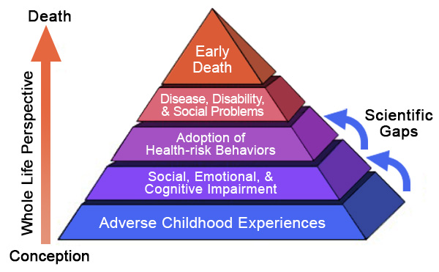
Trauma results from events or circumstances experienced by an individual that can impair the psychological, physical, and social health.
.
5 Protective Factors to Prevent Child Abuse
Parental Resilience
Social Connections
Knowledge of parenting and child development
Concrete support in times of need
Social/Emotional Competence of Children
Adverse Childhood Experiences (ACEs) include:
Emotional abuse and IPV
Sexual abuse
Physical neglect
Household mental illness
Incarcerated household member
Caregiver treated violently
Physical abuse/Emotional neglect
Household substance abuse
Parental separation or divorce
Substance misuse within the home
Symptoms of Trauma May Include:
Suicidality/ Homicidality
Hypervigilance/Physical arousal
Flashbacks and nightmares
Irritability
Depression
Anxiety/ Anger
Dissociation
Avoidance
Trouble Sleeping
Memory issues
Self-medication via substance abuse
Types of Trauma
Community Violence
Domestic Violence
Medical Trauma/Complex Trauma
Natural Disasters
Physical Abuse
Historical Trauma
Sexual Abuse
Neglect
Separation
Death/Grief
Oppression-based Trauma
Effects of Trauma on Parenting Ability
Diminished capacity to respond to stressors in a healthy way
Social risk factors
Mental health issues/Substance abuse
Intimate Partner Violence (IPV)
Risky Adult Behavior

Slide 33
References
Beck, C. T.(1996). A meta-analysis of predictors of postpartum depression. Nursing Research, 45, 297-303.
Callaghan WM, et al. The contribution of preterm birth to infant mortality rates in the United States.
Diana Lynn Barnes, Psy.D and Leigh G. Balber, The Journey to Parenthood: Myths, Reality and What Really Matters, 2007
Logsdon, M. C., Gagne, P., Hughes, T., Patterson, J., & Rakestraw, V. (2005). Social support during adolescent pregnancy: Piecing together a quilt. Journal of Obstetric, Gynecologic, & Neonatal Nursing, 34(5), 606-614.
Long, M. M., Cramer, R. J., Jenkins, J., Bennington, L., & Paulson, J. F. (2019). A systematic review of interventions for healthcare professionals to improve screening and referral for perinatal mood and anxiety disorders. Archives of women's mental health, 22(1), 25-36.
March of Dimes: Long-Term Health Effects of Premature Birth,
March of Dimes: The Impact of Premature Birth on Society,
Mayo Clinic: Patient Care & Health Information, Diseases & Conditions, Preterm Labor
Miller and Rukstalis, 1999.
O'hara, M. W., & McCabe, J. E. (2013). Postpartum depression: current status and future directions. Annual review of clinical psychology, 9, 379-407.
Schmidt R.M,. et al. Journal of Adolescent Health. 2006;38: 712-18
Susan Dowd Stone and Alexis E. Menken, Editors; 2008, and Perinatal and Postpartum Mood Disorders: Perspectives and Treatment Guide for the Health Care Professional
Teresa M. Twomey, J.D .with Shoshana Bennett, PhD, Understanding Postpartum Psychosis, A Temporary Madness, 2009
The United States Department of Justice. Sexual Assault. Accessed at URL:<https://www.justice.gov/ovw/sexual-assault>

Slide 34
www.maternaldepression.org

